Slide 1
Science Project
Energy Pyramids
Scavengers and Decomposers

Slide 2
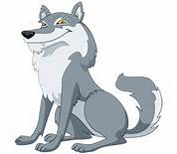
Energy Pyramid
Tertiary Consumer
1
Secondary Consumer
10
Primary Consumer
100
1000
Producer

Slide 3
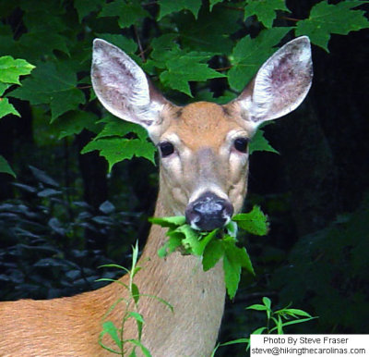
Energy Pyramid Trends and Details
In the energy pyramid each animal gets 1/10th of the energy that the animal originally had so they have to eat a lot of them. But as they go up the food chain they have to eat less because the animals have more energy. Also as you go up the food chain the animals get less and less because if there were more than all the animals lower on the food chain would die.

Slide 4
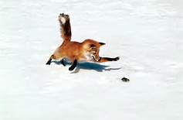
Scavengers
Scavengers are the main reason we have food webs because scavengers eat pretty much everything. They help clean up dead things and they eat small plants and rodents. Scavengers include foxes and lots of different large birds.

Slide 5
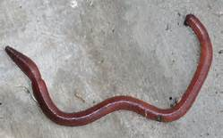
Decomposers
Decomposers basically make things rot. They help make fresh soil and break things down. They are very important because without them there would always be leaves, bones and dead grass all over the ground. Decomposers include earthworms and fungi.

